Slide 1


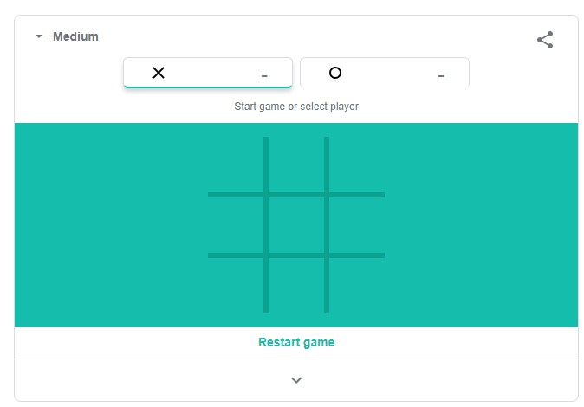
EXPLORE
Play Tic Tac Toe !
5 MIN
2

Slide 2

QUIZ
Is player A the winner here ?
10 MIN
CLASS
[
[A A B],
[A B A],
[A B B]
]

Slide 3
QUIZ
Is player A the winner here ?
10 MIN
CLASS
[
[A A A],
[B B A],
[A B B]
]

Slide 4
QUIZ
Is player A the winner here ?
10 MIN
CLASS
[
[A B A],
[B A B],
[A B A]
]

Slide 5
WARM UP
UNDERSTAND
10 MIN
3
CLASS
Can you explain
the rules of Tic-tac-toe on paper ?
Khmer or English !

Slide 6
EXPLORE
We want to know if A won
5 MIN
1
Divide the steps of your algorithm
Example : step 1 , find if the first column contains only A
[
[A A B],
[A B A],
[A B B]
]

Slide 7
CORRECTION
We want to know if A won
5 MIN
CLASS
Divide the steps of your algorithm
STUDENTS CORRECTION !!

Slide 8
EXPLORE
Q1 : how to use this function to check if A has won on any row ?
5 MIN
1
Example :
Here is the function to check if only A on a row :
[
[A A B],
[A B A],
[A A A]
]
Function name | onlyAOnRow(array2D, row)
Parameter | array2D the tictactoe grid row, the index of the row
Return | True if only A on this row
True
PARAMETERS
RETURN
[
[A A B],
[A B A],
[A B B]
]
Q2 :
Do you need a loop to code this function?
What are the steps of your algorithm
Code this function using word only
1
False

Slide 9
EXPLORE
Q1 : how to use this function to check if A has won on any column ?
5 MIN
1
Example :
Here is the function to check if only A on a column :
[
[A A B],
[A B A],
[A A A]
]
Function name | onlyAOnColumn(array2D, column)
Parameter | array2D the tictactoe grid column, the index of the column
Return | True if only A on this column
True
PARAMETERS
RETURN
[
[A A B],
[B A A],
[A A B]
]
Q2 :
Do you need a loop to code this function?
What are the steps of your algorithm
Code this function using word only
1
True

Slide 10
EXPLORE
5 MIN
1
Here is the function to check if only A on a column :
Question :
Do you need a loop to code this function?
What are the steps of your algorithm
Code this function using word only
Function name | onlyAOnDiagonal(array2D)
Parameter | array2D the tictactoe grid
Return | True if only A on the ascending or descending diagonal
PARAMETERS
RETURN
[
[A A B],
[B A A],
[A A A]
]
True
[
[A A A],
[B A A],
[A A A]
]
True

Slide 11
EXPLORE
ON PAPER
Create the main program to check if A has won the TIC TAC TOE
You need to re use all your previous functions !
20 MIN
1
[
[A A B],
[A B A],
[A A A]
]
[
[A A B],
[A B A],
[A A A]
]
[
[A A B],
[A B A],
[A A A]
]

Slide 12

HOMEWORK
INDIV
Code the TicTacToe on Hackrank

